Slide 1
The added value of Clinical Hypnosis to FND treatment
Dr Jason Price
Consultant Clinical Neuropsychologist

Slide 2
What is Hypnosis?
Hypnosis aims to inculcate a controlled, volitional dissociative, yet focussed state (trance) – based upon controlled attentional processes via suggestion
Trance states are everyday occurrences (e.g. daydreaming)
Clinical Hypnosis as an adjunct to psychological and physical therapies (please note Physio, OT, SLT, Neurology, Nurse colleagues!)
But can have a more direct role in treating FND, due to the similar underlying neurocognitive mechanisms involved in both

Slide 3
“Hypnosis produces a highly focussed, absorbed attentional state that minimizes competing thoughts and sensations”
Oakley, D. & Halligan, P. (2013)

Slide 4
Evidence
Large evidence base:
IBS
Pain
Anxiety/Stress
Enhances effects of traditional psychological therapies
Strong fMRI & EEG evidence of altered neural patterns under hypnosis

Slide 5
FAQs
Is it mind control?
NO
The Hypnotist is just like a Tour Guide….you can choose to follow and listen….or you can choose to do your own thing…or nothing at all
Can anyone be hypnotized?
Most people to some degree
Smaller proportion are ‘highly hypnotizable’

Slide 6
FAQs: Is it dangerous?
Lot safer than medications
Most people find it a pleasant experience
You will NOT accidentally stay in a hypnotic trance
As safe as any other psychological intervention, but could trigger an abreaction, less controlled dissociation, FND symptom

Slide 7
Oh, and you are NOT put into a deep sleep!
Just a focussed attentional state!

Slide 8
Dissociation & FND
DISSOCIATION as a core mechanism in FND:
Function (why it happens)
AND Mechanism (how it happens)
As a result of altered attentional processing
‘‘a disruption and/or discontinuity in the normal integration of consciousness, memory, identity, emotion, perception, body representation, motor control, and behavior’’ (DSM; American Psychiatric Association).

Slide 9
So, why will hypnosis help with FND?
Hypnosis & FND share the same primary process: DISSOCIATION
Works on the mechanism of FND (e.g. dissociation/attention), not necessarily the cause or function – therefore has wide applicability across all FND (unlike other therapies) and don’t need to identify trigger
Can create and remove functional symptoms in experimental conditions

Slide 10
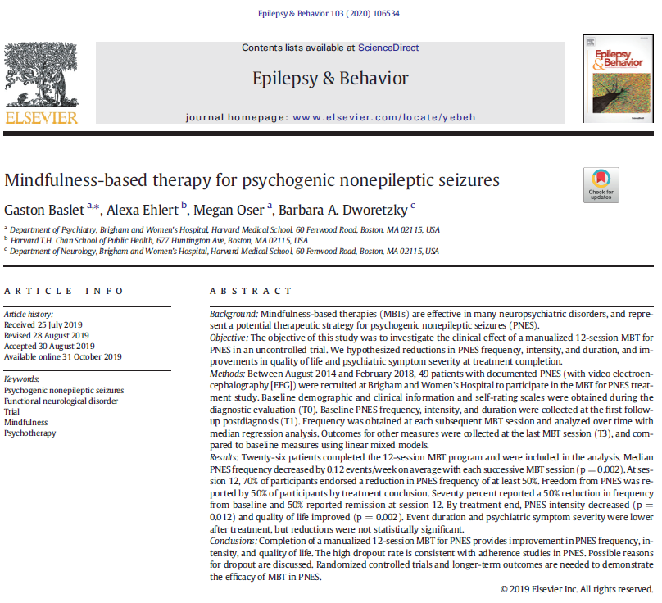
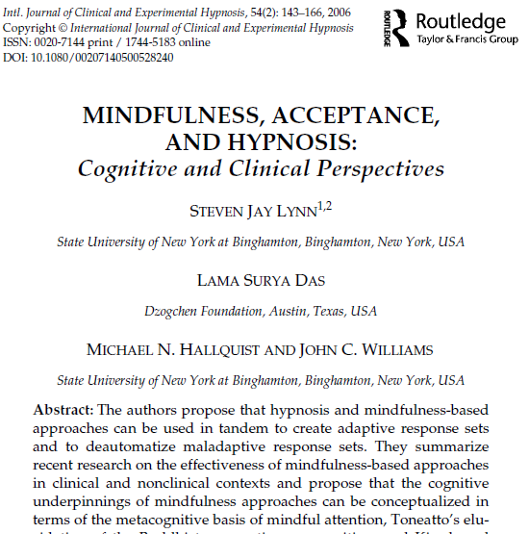
Hypnosis & Mindfulness – attention training
Attention Spectrum
Hypnosis | Mindfulness
De-focus through focus | Focus through de-focus
Dissociation guided focus (‘suggestion’) | (Guided) self-awareness; connectedness

Slide 11
Hypnosis Recreates Functional Amnesia
Jamieson, G.A. et al (2017):
Hypnotic amnesia for previously seen faces
EEG; Alpha changes; N=24
Top down control processes modulate lower level responses
Process ‘protected’ from incongruent (accurate) feedback from internal/external information
Alpha changes consistent with decreased (i.e. inhibited) activity in face processing cortex in HH in amnesic condition
Reversed when removed from suggestion!

Slide 12
Hypnosis treatments for FND Moene et al. (2003):
Hypnosis RCT for motor conversion disorder;,N=44
Manualised, 10 weekly 1 hour sessions; 1 preparatory session; fidelity assessments
30 minutes self-hypnosis each day
Direct suggestions for symptoms alleviation; emotional expression/insight direction
Significant improvement on behavioural symptoms at end of therapy and maintained at 6 month follow-up
No significant differences on general measures of psychological pathology (SCL-90)
[working on mechanism directly]

Slide 13
Hypnosis for FND
‘Basic’:
Rapid relaxation
Positive distraction/attentional re-focussing e.g.:
‘safe-place’
pain modulation
Developing rapid awareness of different emotional, physical and cognitive states
Developing ‘resources states’
Advanced:
Ideo-motor suggestions:
Enhancement of functioning
Alteration of functioning
Cognitive suggestions:
Pre-morbid Regression/imagery to improve functioning
Recreating Dissociative experiences and teaching control

Slide 14
A typical Hypnosis session
Develop an individualised hypnotic script:
Based upon aims of session (e.g. relaxation, ‘safe place’, symptom focussed, resource development, symptom modulation; symptom creation and removal)
‘Induction’ – usually body scan/muscle relaxation suggestions (need to be aware of any contra-indications which might cause distress)
‘Deepeners’ – (e.g. suggestions for ideomotor imagery, deeper relaxation; going through doors, counting, intensity dial)
Imagery; suggestions (direct & indirect) & post hypnotic suggestions
Exit
HYPNOSIS CAN TRIGGER DISSOCIATIVE OR CONVERSION SYMPTOMS; TRAUMATIC IMAGES; ABREACTION

Slide 15
Hypnotic strategies for working with FND Moene et al. (2008); adapted from Deeley, Q. (2016)
Motor FND:
Direct attention upon affected limb; encourage awareness of sensation/movement; positively reinforce
Direct attention upon non-affected limb; encourage awareness of sensation/movement; positively reinforce; suggest that these sensations will flow/transfer to the unaffected limb (hypnotic variation of mirror box intervention!)

Slide 16
Hypnotic strategies for working with FND Moene et al. (2008); adapted from Deeley, Q. (2016)
Motor FND:
Imagination of normal functioning in the past (used in successful mental imagery retraining in stroke); stimulating pre-motor circuits by strong, memory reinforced imagery
Relaxation: [be creative!] general relaxation; specific relaxation of target areas (e.g. of functional spasticity)
Imagination: using imagery to increase function in novel ways (e.g.rolling a ball with foot, balloon in hand)
Functional tremor/shaking:
‘Letting go’ – relaxing, not resisting, shaking off (tensing increases symptoms)
Incongruent imagery (e.g. imagining limbs as heavy an flaccid to reduce movement – similar to HRT in Tourette’s intervention)

Slide 17
Hypnotic strategies for working with FND Moene et al. (2008); adapted from Deeley, Q. (2016)
Dissociative NES:
Recreating or recalling dissociative state/event to gain mastery (perhaps using grounding techniques or attentional control)
Facilitating awareness of trauma images to gain mastery (e.g. desensitization, imagery restructuring, resource overlay; linking past trauma imagery with current symptoms – EMDR type procedures)
Altering perception of prodromal symptoms

Slide 18
Conclusions
Hypnosis has reliable, demonstrable cognitive neuropsychological properties as evidenced in cognitive experiments as well as imaging studies
Works at a primary process level with Dissociation
Hypnosis is already used as part of other ‘mainstream’ psychological interventions & can be used with co-morbid conditions such as PAIN & IBS, ‘stress’ (via relaxation)

Slide 19
Conclusions
Works on mechanism, so don’t need to worry so much about cause
Preliminary evidence of effectiveness in treating FND
Can be used by variety of Helthcare professionals, not just Psychologists/Psychiatrists (Physio, OT, SALT, Neurologists)
Empowering – self hypnosis
Need larger, RCTs to get it ‘on the main stage’

Slide 20
If you want to try hypnosis…
Try to find a practitioner who is also a healthcare professional – in the UK, hypnotherapist is not a statutory regulated title, therefore many hypnotherapists do not have a legally binding professional Code of Conduct – They might also lack necessary clinical skills to deal with issues such as anxiety, depression or abreactions.
Find a Physician, Registered Psychologist, Psychiatrist, Nurse, OT, Physio, SLT will give you this safety from their parent profession.
“conducted only by properly trained and credentialed healthcare professionals (e.g. Psychologists)…who are working within the limits of their professional expertise.” APA Div.30, Society of Psychological Hypnosis
Try to find a practitioner who has experience of working with FND if you are wanting to work directly on the symptoms

Slide 21
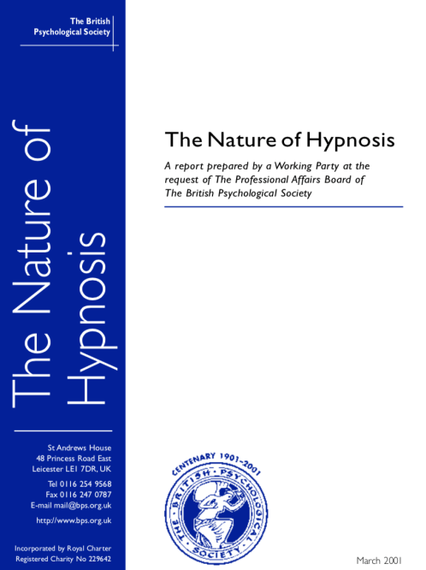
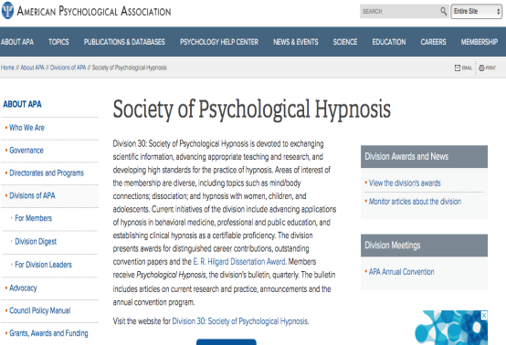
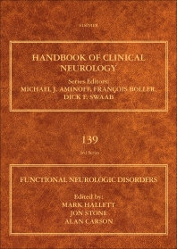
Hypnosis References
People to Google!:
Devin Terhune
David Oakley
Peter Halligan
Quinton Deeley
John F. Kihlstrom
Peter Naish
Irving Kirsch
Steven Jay Lynn
Richard J Brown
Michael Heap
http://neurodigest.co.uk/wp-content/uploads/2020/04/Neurodigest-issue-5-page-12-14.pdf

